Slide 1
Pavilion Data Systems
Internal Sales Training

Slide 2
Table of Contents
Company Overview & Strategy
Product
Target Applications & Objection Handling
Configurations, Schedule, Roadmap, Launch Planning, Pricing
Competition

Slide 3
Company Overview and Strategy

Slide 4



Company Overview
Founded in 2014
We are well funded: Series A -$15M from
Mission: Storing and Processing Data at Tomorrow's Network Speeds
How?: The First Memory Array Designed Like a Network Switch

Slide 5
My Background (I’m old I realized after making this slide)
14 years as a Software Engineer/Engineering Manager
  Tandem Computers (11 years) – OS Kernel, Security, Storage Management
  2 SAAS startups – Director of Engineering
  Brocade – Managed Fabric/Network Management Team
14 years in Product Management
  Brocade, NetApp, PathScale/Qlogic, DataDomain, Fusion-io, Virident/HGST, Pavilion
  Short stint at Violin (8 months) working on PCIe cards

Slide 6
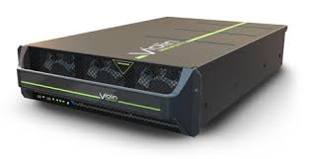

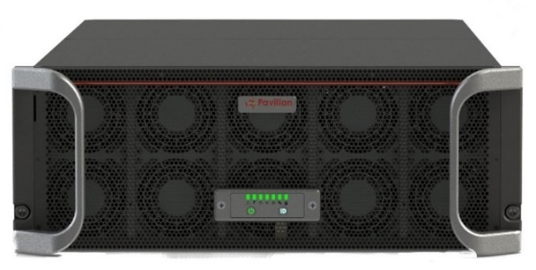

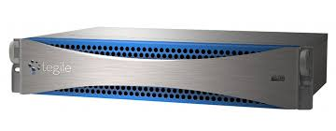
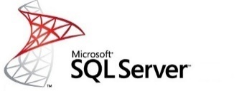

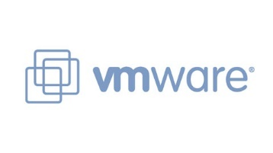



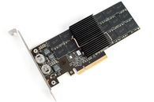


The next step in Performance Storage (R)Evolution…
All Flash Arrays
Pavilion Memory Array
Capacity & Manageability
DAS
Performance (Low Latency and Bandwidth/IOPS)
Notes:
100s of TB per rack-unit, all thin-provisioned
Latency of DAS SSDs
10s of millions of IOPS and over 100 GB/s Bandwidth
10+ 40 GBe ports per rack-unit
Pay as you grow scalability
Standard Ethernet Support
No custom client hardware required
Standards-based protocols
Cost of typical All-Flash-Array

Slide 7


What is wrong with storage systems?
Traditional Architecture – Dual Socket Server
Dual controller architecture, typically dual socket each
  Active/Active
  Active/Passive
CPU
PCIe
Extender
…
Can you use the 72 NVMe drives?
  NO!
4
Ports
CPU
PCIe
Extender
…
Pure, Nimble, Violin, Tegile, 3Par, XtremIO, Tintri, Infiniflash, DSSD are all dual controller

Slide 8
Current Storage Array Architectural Limitations
Ingress: Each 40G network port requires 8 lanes
Egress: Each NVMe drive requires 4 lanes
2 x 40G = 16 lanes
What is the maximum number of drives a CPU can drive?
      ANS: 6 drives
How many drives can a quad CPU deal with?
      ANS: 6 x 4 = 24 drives
How many CPUs will you need for 72 drives?
      ANS: 72 x 6 = 12 CPUs!!
40 PCIe Lanes

Slide 9
Storage Array Designed Like a Switch
Switch Traffic Processed At A Terabit per Second
Storing and Retrieving Data At A Terabit Per Second
NVMe
Drive
Array
Patented 8,966,172 B2
40 x
40 Gbe
Ports
10 Line Cards
4 ports each
20 I/O Controllers

Slide 10


Pavilion Delivers Low Latency AND High Density
Store & Deliver Data at
High Velocity
High-Density Flash Platform

Slide 11
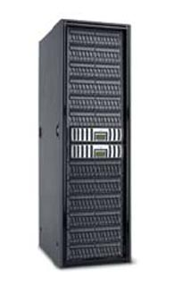


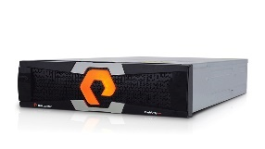
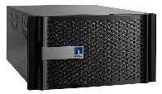
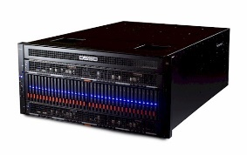
Pavilion Delivers Performance Without Compromise
HDD Arrays
All Flash Arrays
Low Latency Arrays
$
Reliability & Data Management Features
Cost (OPEX/CAPEX)
$$$
Performance (Low Latency and High Bandwidth/IOPS)
Notes:
100s of TB per rack-unit, all thin-provisioned
Latency of DAS SSDs
10s of millions of IOPS and over 100 GB/s Bandwidth
10+ 40 GBe ports per rack-unit
Pay as you grow scalability
Standard Ethernet Support
No custom client hardware required
Standards-based protocols
Cost of typical All-Flash-Array

Slide 12


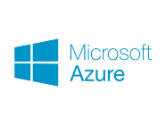

Goal: Democratizing Low Latency Storage
Low Latency Arrays
Low Latency Arrays
All Flash & Hybrid Arrays
Access Frequency
Off-Premesis Cloud Storage
Off-Premesis Cloud Storage

Slide 13



Storage Product Evolution – History is Repeating …
HDD in Server
External JBOD
Volume Management in Server for JBOD
Volume Management in Array
File and Block on Storage Array
PCIe/NVMe Drives in Server
NVMe External JBOF
Volume Management in Server for JBOF
Volume Management in NVMe Array
File and Block on Storage Array

Slide 14
Market Penetration Strategy
All (Block & File)
Virtualization
Latency-Sensitive Applications

Slide 15
Product Overview

Slide 16
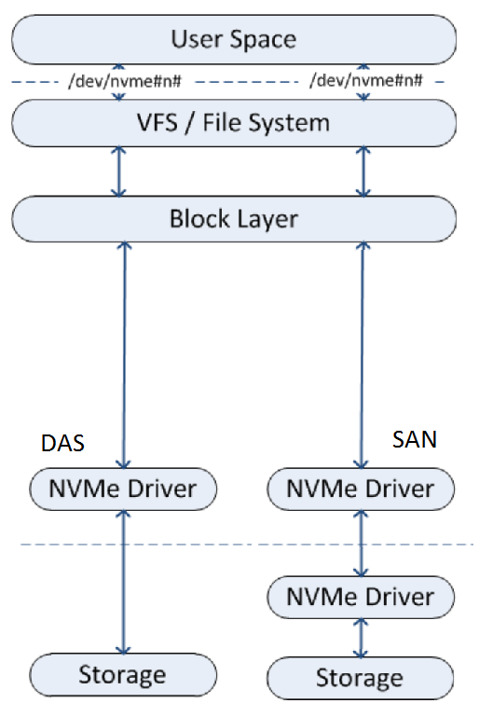
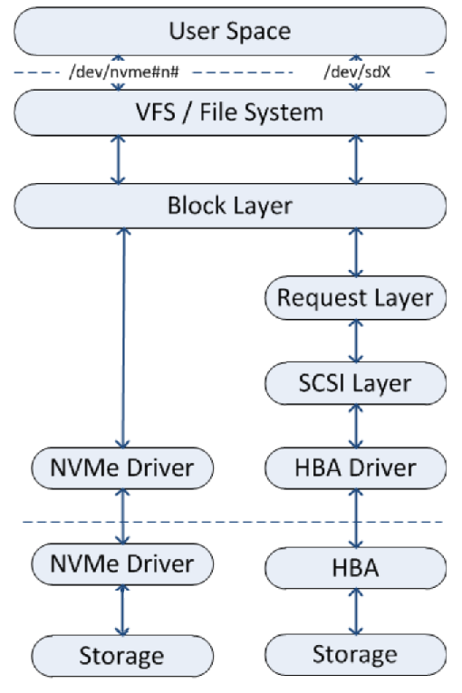
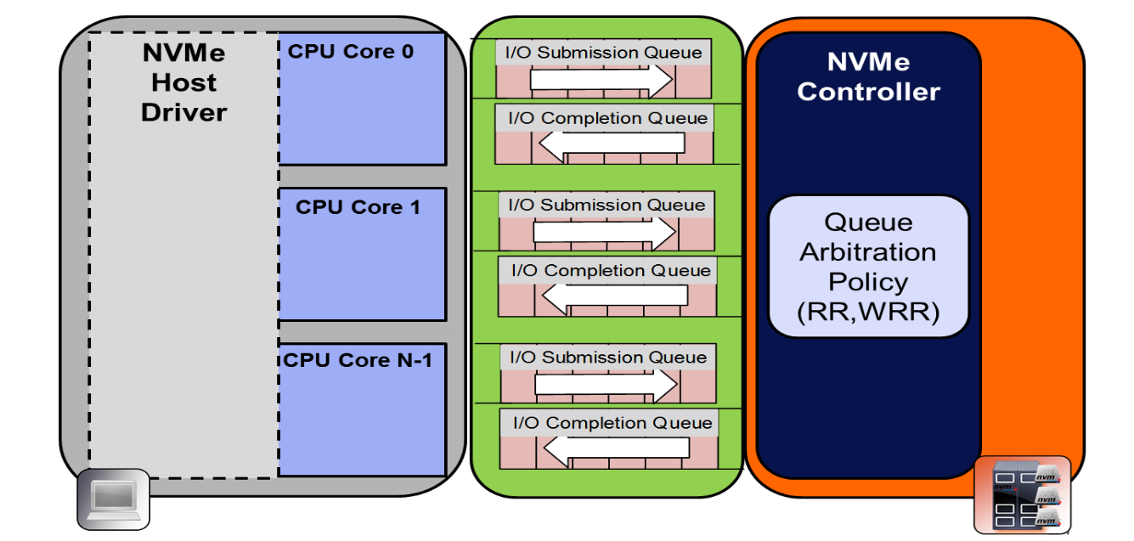
NVMe Basics
All other transports use interrupts and the SCSI stack
  Slows down all CPUs and bottlenecks on a single I/O queue: serial execution
Non Volatile Memory express uses Remote Direct Memory Access (RDMA) with no interrupts and huge per-CPU I/O queues
Doesn’t use the ancient SCSI stack
  Scales linearly with CPU count
  Avoids many data copies for each I/O
  Reduces latency to sub micro-second
  Uses same I/O stack for DAS and SAN
On average, latency
and CPU utilization
are reduced by 50+%
by using NVMe vs
using SCSI
Notes:
(Only use this slide if the audience is not familiar with NVMe. But since that will describe >90% of the audiences for the next year or so… :^))
The I/O stack for all operating systems and SAN transports has a long and distinguished career. Whether FibreChannel or iSCSI for SAN, or NFS, SMB or CIFS for NAS, and especially for SCSI for DAS, the technology is well understood and available from everyone. But because it was designed in the days of 5 ¼” floppies (SCSI stands for Small Computer Systems Interconnect, and was introduced in 1981!), it simply can’t handle the incredible performance of today’s Flash products, whether inside or outside the server’s skin. Because all of the SAN and NAS protocols drop down to SCSI over PCI inside the server, they are all based around processor interrupts and a single I/O queue, forcing all I/O to be done as described by SAS: Serial Attached SCSI. In effect, the I/O from all of your expensive Flash arrays are being squeezed down into a single serial port designed for a 5400 RPM hard drive.
<CLICK> The industry finally got around to recognizing the problem, and proposed a solution to the problem. This is called Non Volatile Memory express, or NVMe. First, NVMe is a transport protocol, which replaces existing protocols like SCSI, SAS and SATA inside the server over PCIe. But it gets rid of a lot of the problems of those protocols:
NVMe bypasses kernel mode for I/O, and uses your user memory for Direct Memory Access inside the server, and Remote Direct Access Memory for SAN and NAS solutions. Effectively, you treat all devices, either local or remote, as if they were local and you have direct memory access to the device for both reads and writes.
NVMe simply doesn’t use interrupts (which are terribly slow for modern devices) but uses RDMA semaphores to let you know when a read or write is finished.
NVMe gets rid of the single I/O queue per system and implements queues of 64K *PER CORE*, and the architecture allows up to 64K queues per device, so you can have a lot of I/O going on at the same time. And finally,
<CLICK> NVMe doesn’t use the SCSI stack. SCSI is simply too slow, with too much overhead, and too much code that was designed for floppy diskettes that is kept around for compatibility reasons, to have any place in ultra-high-speed Flash devices. Multiple groups have measured it, and the results are consistent: moving from SCSI to NVMe will reduce the CPU overhead and I/O latency by more than half, removing a bottleneck which is slowing down existing devices.
The advantages of this are many:
<CLICK> It scales linearly with the number of CPUs. Each core has its own I/O queue with a potential I/O queue depth of 64 thousand entries, and does its own I/O with local user mode memory, with no interrupts, just memory accesses.
<CLICK> The data is transferred to and from user mode memory, directly to and from the target storage device. In the other transports, a write involves copying the data from user mode memory to kernel mode memory, possibly then copying it again to the PCIe card’s memory, and then placed on the transport line. For reads, the data is often take from the transport line into the PCIe card’s memory, copied to kernel mode memory, and then copied again to user mode memory. Each copy is done at memory speeds, but they still take time. NVMe eliminates all of those copies.
<CLICK> The net effect of eliminating interrupts, eliminating huge chunks of the I/O stack and eliminating the data copies, while allowing all of the processors to work in parallel, is to reduce the latency of the I/O to sub micro-second.
<CLICK> NVMe and NVMe over Fabric use exactly the same I/O stack, because they both use RDMA. So the protocol you use to talk to local SSDs and the protocol you use to talk to a SAN based SSD, are identical. NVMe SSDs inside the server are common today, and are demonstrating dramatic performance gains over SAS and SATA SSDs. Because local NVMe and NVMe over Fabric uses the same I/O stack, this same kind of reduction in overhead and increase in performance is available today in the SAN as well.
And what is most interesting, is that you have been thinking about how all of these points apply to the host server, and you are right to think that: high CPU counts, no data copies, and reducing latency are important for the host server to be able to drive the massive number of IOPS that are needed for today’s requirements.
But these points apply equally to the storage array as well. Being able to scale IOPS simply by having more processors, avoiding data copies, reducing latency, and equally importantly, not having the speed of the actual storage SSDs throttled by the SCSI stack but instead using NVMe as a transport for both the SAN and the internal communication, means that we can create a truly high speed, highly scalable, extremely low latency storage array, that delivers on the promise of SSDs and NVMe.

Slide 17
A New Kind of All-Memory Shared Storage Array
Powerful
  Half PB in 4U
  Up to 20 Million 4K IOPS
  Up to 120 GB/s Bandwidth
  40 x 40 Gbe Ports
Enterprise Class
  Frictionless Deployment
  Data Resiliency & HA
  Guaranteed QOS
  Scalable Data Copies
  Full Management Suite
Superior Value
  Pay-As-You-Grow
  Increase Storage Utilization 10X+
  Increase the Value of Data
  Leverages Commodity SSDs

Slide 18
Pavilion Product Family
RF-140
Ports (40 Gbe) | 40
Capacity (TB) | 115 / 230 / 460 / 920
Read BW | 120 GB/s
4K Read IOPS | 20 Million
RF-116
Ports (40 Gbe) | 16
Capacity (TB) | 28 / 57 / 115
Read Bandwidth | 48 GB/s
4K Read IOPS | 8 Million
RF-108
Ports (40 Gbe) | 8
Capacity (TB) | 14 / 28 / 57
Read Bandwidth | 24 GB/s
4K Read IOPS | 4 Million
Expansion Options for any model
IO Line Card (4 x 40 Gbe Ports, 2 Storage Controllers)
Capacity Expansion Packs - 7, 14, 28, or 57 TB
*Bandwidth measured using block sizes >= 32K

Slide 19
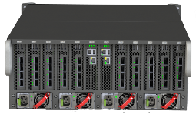

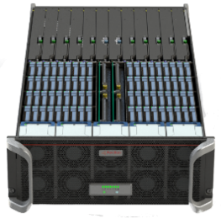
Key Features
Up To 120 GB/S
Bandwidth
Half PB
Capacity (4U)
*1 PB in mid-2017
Thin
Provisioning
RAID-6
Zero
Host
Footprint
Up To 20 Million
4K IOPS
Symmetric
Active-Active
Controllers
Full HA Support
Up To 40 x
40 Gb/S
Ports
Pay-As-You
Grow Scalability
in 4U Chassis
High Speed
Data Copies/
Clones

Slide 20
Storage Array Designed Like a Switch
Switch Traffic Processed At A Terabit per Second
Storing and Retrieving Data At A Terabit Per Second
NVMe
Drive
Array
Patented 8,966,172 B2
40 x
40 Gbe
Ports
10 Line Cards
4 ports each
20 I/O Controllers

Slide 21
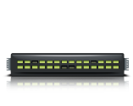
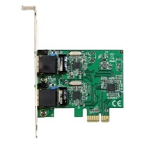
Only NVMe Array with Symmetric Active-Active Controllers
Network Path A
C1
V1
Pavilion NVMe Host Volume V1
C2
V1
IO Line Card 1
C3
Network Path B
C4
Shared NVMe Media Group
V1
IO Line Card 2
Simultaneous, Concurrent Read/Write Access to any volume through multiple Pavilion array controllers
Provides load balancing across multiple network paths and target controllers for improved performance
Delivers failover capability across up to 5 controllers for a given volume

Slide 22
Existing Designs can’t deliver value of today’s media
Traditional Architecture – Dual Socket Server
Pavilion Architecture ( Patented 8,966,172 B2)
Management Controller(2)
CPU
PCIe
Extender
…
4
Ports
10 Line Cards
2 sockets each
4 ports each
NVMe
Drive
Array
40 x 40 Gbe
Ports
CPU
PCIe
Extender
…
Multi-Terabit, Redundant PCIe Fabric
Scale Connectivity and Controller CPU Sockets as needed
No single point of failure - all Components Hot Swappable
Systems Management, Thin Provisioning, Erasure Coding
Single Point of Failure
Choke Point - Network and Compute are Not Scalable

Slide 23
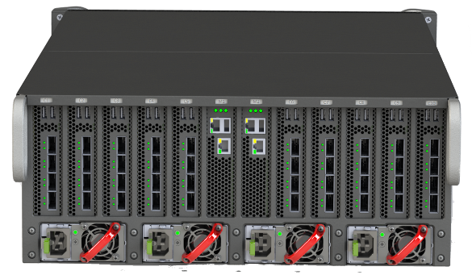
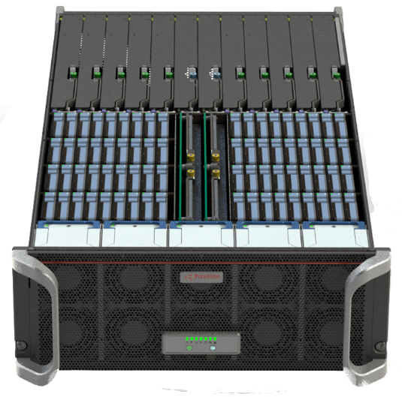
Hardware Overview
Rear View
Top View
Commodity NVMe SSDs (72)
PCIe Fabric Modules (2)
40 GbE Ports
Supervisor/Management Modules (2)
Power Supplies (4)
IO Line Cards (10)
Fans (8)

Slide 24
Pay-as-You-Grow Linear Scalability
10 IO Line Cards
5 IO Line Cards
3 IO Line Cards

Slide 25
Low Cost Of Ownership + Enterprise Reliability
No Custom Software or Hardware required in hosts/application tier
Standard Ethernet Connectivity
Erasure Coded Volumes
Thin Provisioned Volumes
High Speed Clones
QOS Policy per Volume
Thin-Provisioned, virtual NVMe LUNs presented on host tier

Slide 26

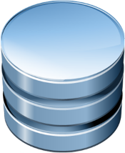
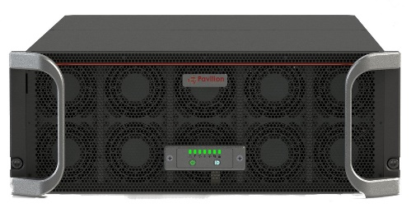
High Speed Data Copies Increase Productivity
Production
Development
QA
Decision
Support
Reporting
Training
Demo
Instant, Space-Efficient, Logical Copies
Full Performance Copies
Reduce Overhead on Servers
Eliminate Backup Windows

Slide 27
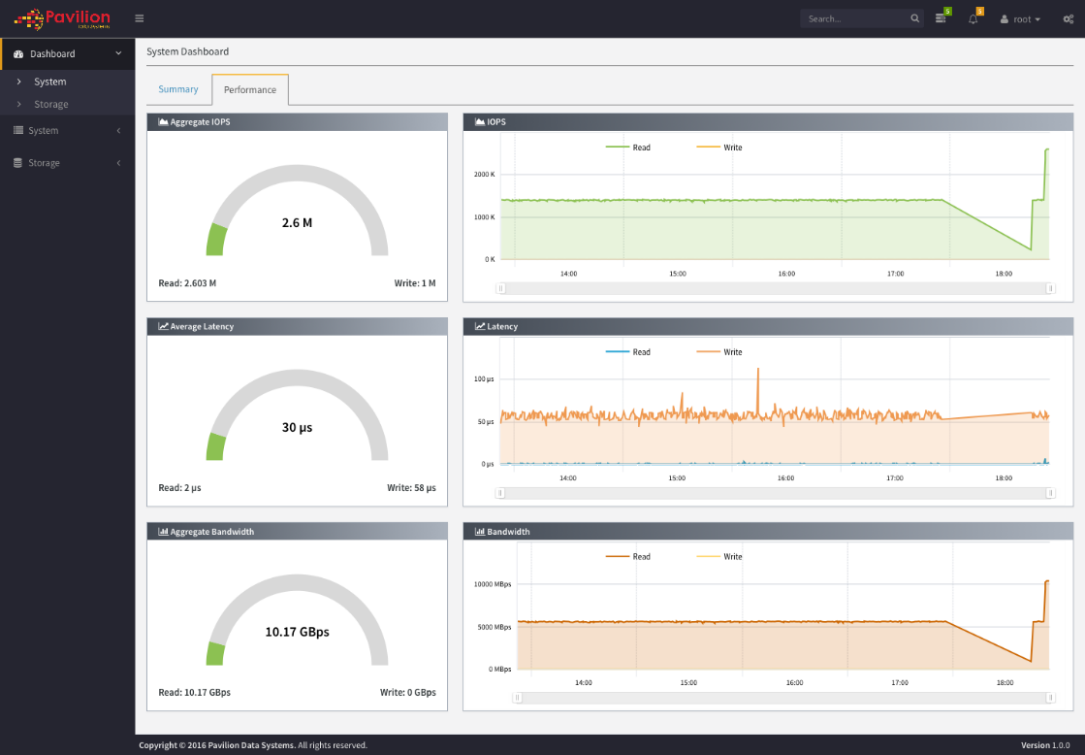
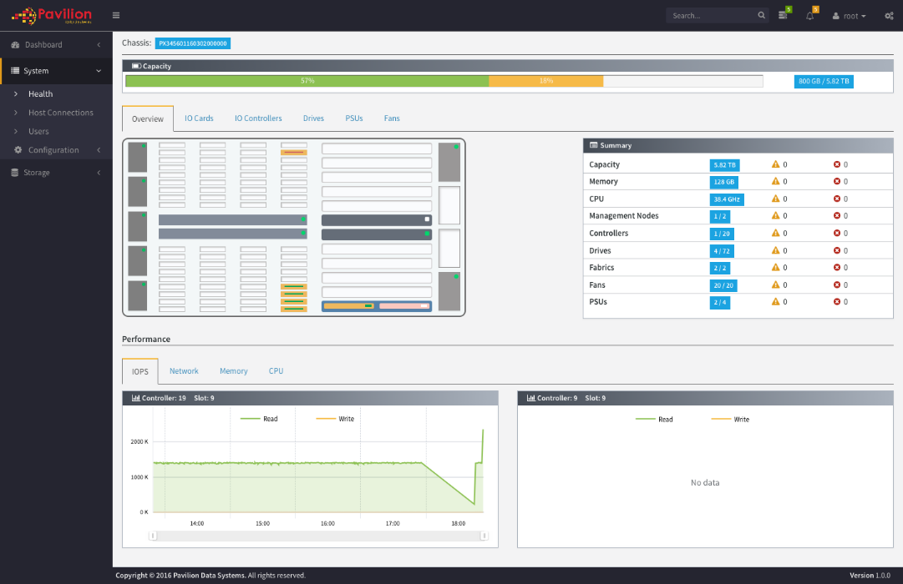
Enterprise Management
Web-Based UI
REST API
SNMP

Slide 28
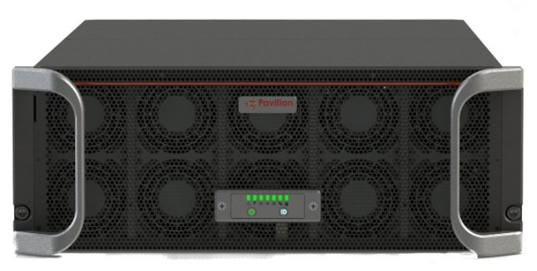
Pavilion: Next-Generation Storage
Game-Changing Class of Storage
  20x the performance, 10x better latency, and 4x the density of a traditional All Flash Array.
Record-breaking Scalability
  Up to 40 x 40 Gbe ports in a 4U appliance, all delivering full bandwidth storage performance.
Reliability
  No Single Point of Failure. Erasure Coding. 6 x 9s Availability.
Scale in Multiple Dimensions
  Performance, Capacity (up to 460 TB in 4U), or both
Ease of Deployment
  Standard Ethernet Connectivity. No custom, host-side hardware required. Leverages standards-based NVMe-over-fabrics protocol. Thin-Provisioned NVMe Volumes presented on each host. QOS/SLA policies per-volume.
Pavilion Data Systems™ Confidential
Page 28

Slide 29
Target Applications

Slide 30

The Problem: Digital Business Puts Pressure on Storage
Networks Getting Faster
New Business Expectations
STORAGE under PRESSURE
Changing Application Needs
Host Processing Power Increasing
Data Growth Accelerating

Slide 31



Pavilion Benefits for Applications
High Performance & Density
Reduce Costs
10X+ improvement in performance and latency vs. All-Flash Array
10x+ more users for the same amount of
infrastructure
Better Decisions from a larger data set
Increase utilization
Reduce Physical Data Copies
Reduce Software Licensing Costs
Faster ROI
Reduced Administrative Costs
High Availability
Control Data Sprawl
Avoid Information Downtime
No Single Point of Failure
Hot-Swappable components
6x9s
Leverage High-Speed Logical Copies
Concurrent Use of Data for Many Purposes
Derive More Value from Data

Slide 32






Target Applications for Shared, Low Latency Block Storage
Scale-Out Database (Analytics/OLTP)
Analytics & ETL Applications
Reduce per-rack costs up to 72%
Improve Storage Utilization 2X+
Management Flexibility
Reduce Infrastructure
Shorten Decision Times
Transition to Real-Time Analytics
Increase Accuracy
Driving Continuous ETL

Slide 33
Scale Out Databases
Custom Applications for OLTP and Analytics

Slide 34

Business Demands Challenge Traditional Approaches
Performance and Capacity determined at procurement time
Blindly adding capacity
Data trapped in storage silos
Low utilization
Storage refresh coupled to server refresh cycles
Ad hoc flash usage
Cost
Complexity
Inflexibility

Slide 35
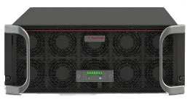
Replace DAS in Scale Out Database Deployments
Reduce per-rack costs up to 72%
Improve Storage Utilization 2X+
  Free up stranded capacity residing on DAS
Management Flexibility
  Less raw storage deployed lowers IT Admin Costs
  Move data sets from one server to another without copying
Reduce Infrastructure
  Less Servers required, or consolidate more DB instances per server
  Eliminate DAS SSDs
  Leverage Full-Performance, Space-Efficient Copies
Rack-Level Failover

Slide 36
Pavilion Lowers HyperScale DB CAPEX + OPEX by 72%
$1,328,6400
72% Savings Total Year-1 Costs
38% Savings Infrastructure Costs
$370,1620

Slide 37
Sustained Mixed Performance
Pavilion Volume
Average 70:30 IOPS
858,420
Variation Coefficient
1.7%
Simulated Results – Need Update
HGST 1.6 TB NVME
Average 70:30 IOPS
325,640
Variation Coefficient
2.0%

Slide 38
ETL, (Packaged) Analytics, DataBase

Slide 39
Top 5 markets – Fast Data (IDC)
Revenue (at least 2B each)
Growth (at least 24% CAGR)
Discrete Manufacturing
Banking
Process Manufacturing
Professional Services
Healthcare
Banking
Securities & Investment Services
Media
Telecommunications
Retail
Target Workload: Multistage analytics workflow against growing data
IDC report for DSSD: http://www.emc.com/collateral/analyst-reports/us41041316.pdf

Slide 40

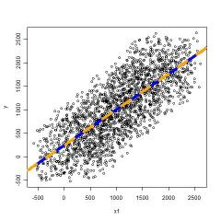



SIEM Requires Fast + Big Data
Shorten Decision Times
  Low Latency/High Capacity platform delivers processing at the speed of business
  Handle Millions of Events per Second and analyze in real time
  Simultaneous analysis using high-speed space-efficient copies
Increase Accuracy
  Stream & Batch Data: Add more data to increase accuracy, rather than optimizing algorithms
  Over 100 TB per Rack-Unit

Slide 41


Accelerate Splunk with Pavilion
Use a single Pavilion Memory Array for all Splunk Indexer Data
Accelerate Search Times up to 100x
Common standard Ethernet network for servers and storage
Move analysis and decision making from batch to real time
Reduce infrastructure footprint up to 4X, along with associated power and cooling costs
Indexer 1
Indexer 2
Indexer 3
Indexer N

Slide 42



Analytics & ETL: The Problem
Data Growth Expanding
ETL & Analytics
Turnaround Times Not Met
Lost Business
Opportunities

Slide 43


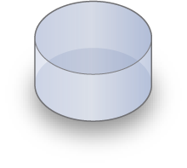

ETL Process
ERP
Extract
CRM
Transfer
Data
Warehouse
Business
Intelligence
Load
POS
Data Marts
Finance

Slide 44

Solution: Pavilion Drives Continuous ETL and Lower Cost
Pavilion
Data Warehouse
Business
Intelligence
Reduce ETL Window 5X
More Simultaneous Usage
Rapid Analysis
Predict Instead of React
Reduce ETL Infrastructure Sprawl 10X
Less Servers and Storage Arrays
Multiple Loads in Parallel
High Bandwidth Data Ingest

Slide 45

Traditional Database
Improve Database Performance 10X+
Deliver Efficient, High-Performance DB Clones for Test/Dev and Backup
  Low latency/High IOPs subsystem to host copies
  Allow for many copies to simultaneously do I/O without performance loss
  Scale-out controller architecture to remove controller bottlenecks
Offload Database Application Servers
  Alleviate the need to replicate data by using space-optimized snapshots

Slide 46
Scale Oracle RAC on Pavilion
RAC Node 1
RAC Node N
Oracle ASM & Oracle Clusterware
V1
…
VN
…
…
V1
VN
20X+ improvement in performance over traditional AFAs
Support more DB Instances on Less Infrastructure
…
V1
VN

Slide 47
Pavilion Lowers Delivery Cost of Traditional Databases
$13,952,500
Pavilion delivers 30% Savings on Delivery Cost vs Traditional AFA
$9,131,000
$6,350,500
Low Latency Drives Savings in multiple areas

Slide 48
Configurations, Schedule, Roadmap, Launch Planning, Pricing

Slide 49
System Configurations
 | RF108-18 | RF116-36 | RF140-72
# of NVMe Drives | 18 | 36 | 72
Raw Capacity (TB) | 14 / 28 / 57 | 28 / 57 / 115 | 115 / 230 / 460 / 920
IO Line Cards | 2 | 4 | 10
Storage Controllers | 4 | 8 | 20
40 Gbe Network Ports | 8 | 16 | 40
System Bandwidth (GB/s) | 24 | 60 | 120
Mixed 4K IOPS (70:30) | 4M | 8M | 20M
System Height (RU) | 4
Expansion Options | IO Line Cards/Controllers, 9-Drive Capacity Packs

Slide 50
Client Operating System Support
Linux OS Support
Operating System. | OS version | Kernel | Mellanox OFED driver | NVMeOF driver
RedHat Enterprise Linux | 6.8, 7.x | 3.10 to 3.15 | Available | Available
Oracle Enterprise Linux |  | 3.16 to 4.7 | In-Box | Available
CentOS |  | 4.8+ | In-box | In-box
RedHat Enterprise Linux | 6.5, 6.6, 6.7, 6.8 | 2.6 | Available | Available
Oracle Enterprise Linux
CentOS
Citrix Xen Server
Ubuntu Linux | 14.10 - 16.04 | 3.16 – 4.7 | In-Box | Available
Ubuntu Linux | 16.10 | 4.4, 4.8 | In-Box | Available

Slide 51
Product Schedule
1.2: Alpha (January 2016)
  Final Hardware
  Management GUI for provisioning and monitoring
  No HA Features
1.3: Beta (March 2017)
  All data management features included – Erasure Coding, Snapshots/Clones
2.0: Limited Availability (April 2017)
  Systems with Warranty/Support

Slide 52
Roadmap … “Under Construction”
Version 2.0 – 2H 2017
  920 TB Max Capacity
  VMWare Support
  Windows Support
  Encryption at Rest
  Sync and Async Replication
  Deduplication and Compression
Version 3.0 – 2H 2018
  File Serving (NFS)
Under Consideration: 2U Form Factor, 25/50/100 Gbe, Fibre Channel, …

Slide 53
Launch Plan
“Soft Launch” in August 2016
  Displayed system at Flash Memory Summit in Seagate Booth
  Published initial Web Site with minimal information
  Goal was to have something to reference by customers we meet with
Full Launch in Q2/Q3
  Full specs on the web site, including data sheet
  Application/Solutions collateral
  Press Release
  Analyst/Press Interviews
  Customer Case Study(s)
  Price List
  Sign up 2-3 US Resellers

Slide 54
Other Logistics
Available Collateral (on Google Drive)
  Web Site
  This Presentation
  Data Sheet
  White Paper (Internal Only Currently, but good for background/training)
  Quick Start Guide (Available in December)
Tools
  Sharepoint – repository for the above collateral
  ZOHO CRM Tool – will create accounts for all Sales personnel

Slide 55
Competition

Slide 56
3 Categories of Competitors
Shared-Nothing DAS SSD-based clusters
  Used by Cloud/Hyperscale Customers for Custom Applications on NoSQL/MySQL
NVMe-based “Just A Bunch Of Flash (JBOF)” Appliances
  Startups pushing this emerging category offering ‘no frills’ performance
Traditional All-Flash-Arrays (AFA)
  iSCSI/FC Arrays from traditional enterprise vendors

Slide 57
1. Shared-Nothing DAS SSD-based Clusters
Cost
Performance and Capacity determined at procurement time
Blindly adding capacity
Data trapped in storage silos
Low utilization
Storage refresh coupled to server refresh cycles
Complexity
Inflexibility

Slide 58
1. Replace DAS in Scale Out Database Deployments
Reduce per-rack costs up to 72%
Improve Storage Utilization 2X+
  Free up stranded capacity residing on DAS
Management Flexibility
  Less raw storage deployed lowers IT Admin Costs
  Move data sets from one server to another without copying
Reduce Infrastructure
  Less Servers required, or consolidate more DB instances per server
  Eliminate DAS SSDs
  Leverage Full-Performance, Space-Efficient Copies
Rack-Level Failover

Slide 59
Objection Handling vs. Direct-Attached SSDs
Your $/GB cost is higher than I pay for SSDs today
  Utilization with our platform will increase 2X or more most likely if no data copies are used, and if our snapshot technology is utilized it will increase from there, allowing you to buy less raw capacity
I believe in ‘shared nothing’ architecture so I can isolate failures to a single server – shared storage increases the failure ‘Blast Radius’
  Consider making the entire rack a failure unit

Slide 60

2. JBOFs (Just a Bunch of Flash)

Slide 61
Storage Product Evolution – History is Repeating …
HDD in Server
External JBOD
Volume Management in Server for JBOD
Volume Management in Array
File and Block on Storage Array
PCIe/NVMe Drives in Server
NVMe External JBOF
Volume Management in Server for JBOF
Volume Management in NVMe Array
File and Block on Storage Array

Slide 62
Frictionless Deployment
Host-Side Implementations (JBOFs)
Pavilion = Zero Host Footprint
Applications
Applications
Data Services
Host
NVMeOF, Direct PCIe, or Proprietary Protocol
Network
NVMe Over Fabrics
Data Services
NVMe Drive Pool

Slide 63
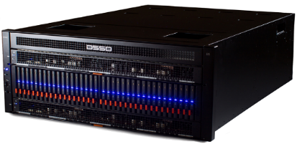
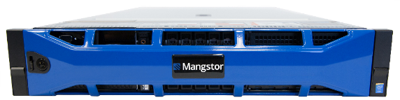
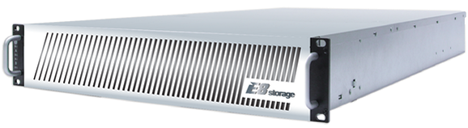

Only Low Latency Array with ZERO Host Footprint
All Require Custom Hardware OR Software to be installed on all Hosts
Increased Complexity
Higher Cost
Reduced Reliability
Standard Host Drivers (NVMe-over-Fabrics)
No Custom Client Software Required
No Custom Client Hardware
Leverages Standard Ethernet Network
All Data Management Processing Performed in Array, none in Hosts

Slide 64


Pavilion vs. JBOFs
Density / Rack-Unit (TB) [Total] | 115 [460] | 29 [144] | 86.5 [173] | 27 [54] | 76 [152]
Rack-Units | 4 | 5 | 2 | 2 | 2
Bandwidth / RU (GB/s) [Total] | 30 [120] | 20 [100] | 20 [40] | 10 [20] | 36 [72]
4K IOPS / RU (Millions) [Total] | 6.25 [25] | 2 [10] | 5 [10] | 2.5 [5] | 8.9 [17.8]
Number of Ports | 40 x 40 Gbe | 48 (PCIe) | 8 x 40/50/100 Gbe | 2 x 40/50/100 Gbe | 32 x 40 Gbe
Leverages Commodity NVMe SSDs |  | ✗ |  |  | ✗
Standard Ethernet Support |  | ✗ |  |  | ✗
Snapshots/Clones |  | ✗ | ✗ | ✗ | ✗
Requires No Custom Client Hardware |  | ✗ |  |  | ✗
Requires No Custom Client Software |  | ✗ | ✗ | ✗ | ✗

Slide 65
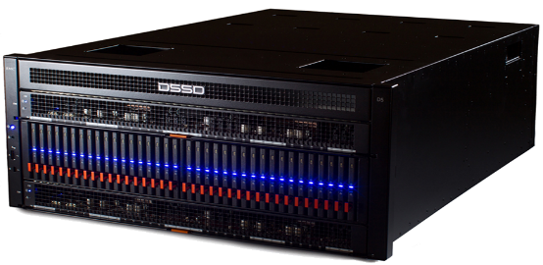
Pavilion vs. EMC DSSD D5
 | Pavilion | EMC DSSD D5 | Notes
Leverages Standard Ethernet | ✓ | ✗ | Lower cost of ownership
22M 4K Read IOPS 3.8 M 32K Read IOPS | ✓ | ✗ | Pavilion is 2X the Performance of D5
No Custom Client Hardware or Software Required | ✓ | ✗ | D5 Requires Custom Network Cards to be installed in every client
Leverages Standard Commodity Storage Hardware | ✓ | ✗ | Enables Rapid software-based innovation
Leverages Standards-based protocol NVMe-over-Fabrics | ✓ | ✗ | Reduced cost of ownership through ease of deployment
$/GB Cost @ Typical AFA Prices | ✓ | ✗
Density up to 460 TB in 4U | ✓ | ✗ | D5 offers less than half the density
Pavilion Data Systems™ Confidential
Page 65

Slide 66
3. All-Flash-Arrays

Slide 67
Pavilion Delivers A New Class of Storage
 | Traditional All Flash Array (Violin, NetApp EF, Pure, EMC XtremIO, etc) | Pavilion Advantage
External Connectivity Bandwidth | 4-8 GB/s | 20X
Internal System Fabric Bandwidth | < 512 Gb/s | 15X
IOPS and latency | < 1000K IOPs (4K Block) Latency: 1 ms | 25X IOPs 10X Latency
Performance/Server (assume 50 servers/rack) | ~ 1K IOPs (32K Block) ~ 0.08 GB/s Bandwidth | 25X
Performance-Sensitive Workloads will migrate to this new category of storage
Pavilion Data Systems™ Confidential
Page 67

Slide 68
Objection Handling vs. AFAs
I don’t know if I need this much performance
  Most customers only focus on incremental upgrades during refresh cycles, so try to get the customer to fundamentally re-think what they can do with this level of performance
  Consider OPEX reductions when performance management is eliminated
I need deduplication and compression
  Data Reduction adds latency and lowers performance
    No other low latency platform offers data reduction
  We will address using discounting to match AFA effective $/GB pricing
I don’t use 40 Gbe – all of my Enterprise workloads are on FC
  Port cost comparison vs. FC – FC is expensive

Slide 69
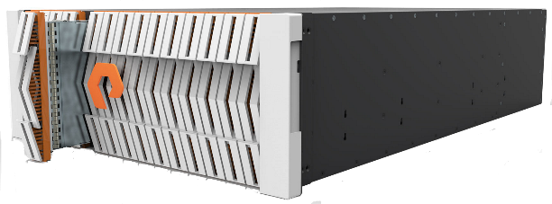
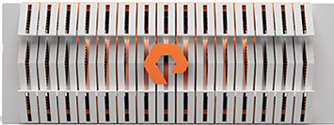
Pavilion vs. Pure Storage FlashBlade
 | Pure FlashBlade | Pavilion Advantage
External Connectivity Bandwidth | 16 GB/s | 7.5X
Top Capacity | 132 TB 792 TB | 3.5X 15%*
IOPS and latency | < 1000K IOPs (4K Block) Latency: 1 ms | 20X IOPs 10X Latency
Access Protocol | File Only | Block
* Pavilion 920 TB and FlashBlade 792 TB available in Q1
Pavilion Data Systems™ Confidential
Page 69

Slide 71

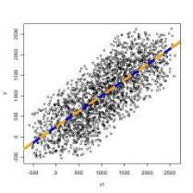
Why Do We Need A New Storage System?
Application <-> Data Gap is Growing
Storage Platforms Can’t Keep Up, including All-Flash-Arraysh-Arrays
Storage latency costs money
Today’s solutions can’t deliver both low latency and capacity
  Analyzing a larger sample leads to better answers
  Data needs to be processed at the speed of business
A New Approach is Required to Deliver Next-Generation
Storage Capabilities

Slide 72

A New Kind of All-Memory Shared Storage Array
120 GB/S
Bandwidth
Half PB
Capacity (4U)
*1 PB in Q1-2017
Pay-As-You
Grow Scalability
in 4U Chassis
Zero
Host
Footprint
25 Million
4K IOPS
Erasure Coding
Hot Swappable
Components
Up To 40 x
40 GB/S
Ports
High Speed
Data Copies/
Clones
Thin
Provisioning

Slide 73
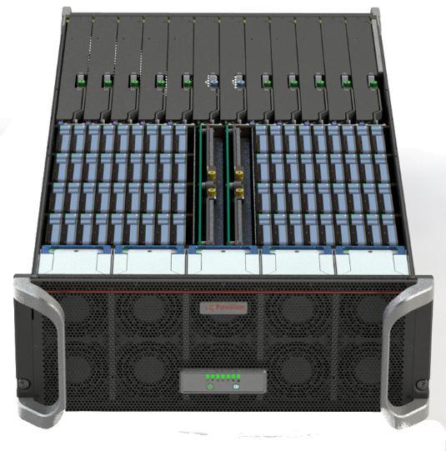
System Overview
Pavilion Memory Array ( Patented 8,966,172 B2)
Management Controller(2)
NVMe
Drive
Array
40 x
40 Gbe
Ports
10 Line Cards
4 ports each
20 I/O Controllers
Internal, Multi-Terabit, Redundant PCIe Fabric

Slide 74
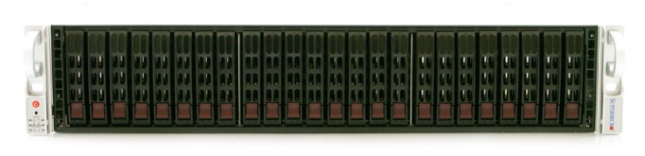


Pavilion vs. Apeiron
 | Apeiron | Pavilion
Density > 100 TB/Rack Unit
Standard Network Adapter Support
Standard Network Protocol Support (NVMe Over Fabrics)
No Custom Client Hardware Required
No Custom Client Software Required
Pavilion Data Systems™ Confidential
Page 74

Slide 75

ETL (Extract, Transform, Load) As-A-Service
ETL Clients
Enterprise Data
ETL Application Farm
ETL Warehouse

Slide 76
Capacity and Performance Density
  Up to 25 Million IOPS, 120 GB/s Bandwidth, 10s of microseconds latency
  Up to One Half PB of Flash Memory in 4U
  Provision 1000s of virtual NVMe block storage volumes on hosts
Enterprise Data Management
  Thin Provisioning
  High-Speed Virtual Data Copies
  Full-Featured Web-Based Management Console, REST API, SNMP
Capacity and Performance Density
Up to 25 Million IOPS, 120 GB/s Bandwidth, 10s of microseconds latency
Up to One Half PB of Flash Memory in 4U
Provision 1000s of virtual NVMe block storage volumes on hosts
Enterprise Data Management
Thin Provisioning
High-Speed Virtual Data Copies
Full-Featured Web-Based Management Console, REST API, SNMP
Enterprise Reliability
Full HA Capability
Hot-Swappable Components
Data preservation in the event of power loss and drive failure(s)
Pay-As-You-Grow Scalability
Add IO Line Cards to Increase Performance, as needed
Add NVMe SSD Drive Packs to Increase Capacity, as needed
Scale Performance and Capacity independently, within a single chassis
Frictonless Deployment
Plug and Play
Standard Ethernet Connectivity
No Custom Hardware required on Application Servers/Hosts
No Custom Software required on Application Servers/Hosts
Leverages Standard in-box NVMe-Over-Fabrics Driver

Slide 77
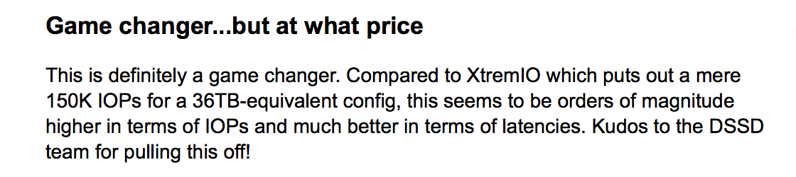
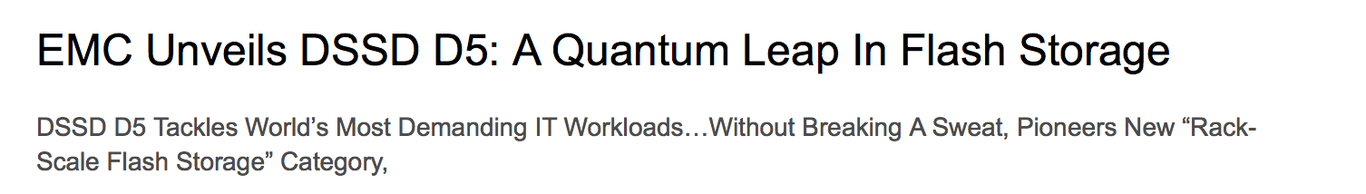
DSSD Buzz feed…
Lists @ 3M$
for 100TB

Slide 78
Tentative System Configurations and Specifications
 | RF108-18 | RF108-36 | RF140-72
Number of NVMe Drives | 18 | 36 | 72
Raw Capacity (TB) | 28 / 57 | 57 / 115 | 115 / 230 / 460
IO Line Cards | 4 | 4 | 10
Storage Controllers | 8 | 8 | 20
40 Gbe Network Ports | 16 | 16 | 40
System Bandwidth (GB/s) | 30 | 50 | 120
Mixed 4K IOPS (70:30) | 6M | 6M | 17M
System Height (Rack Units) |  | 4
Expansion Options | IO Line Cards/Controllers, 6-Drive Capacity Packs

Slide 79
Low-Latency,
Thin-Provisioned, Logical NVMe Volumes presented on all MySQL Database Nodes over standard Ethernet Network

Slide 80
 | Apeiron | Pavilion
Density > 100 TB/Rack Unit
Standard Network Adapter Support
Standard Network Protocol Support (NVMe Over Fabrics)
No Custom Client Hardware Required
No Custom Client Software Required

Slide 81
Converged or Disaggregated Shared Block Storage?
 | Converged | Disaggregated
Scale Compute and Storage Independently
Uses Commodity Storage Components
No Host Application CPU Overhead
No Custom Software Required on Hosts
Latency and Performance of Local SSDs

Slide 82
Comparing Pavilion and Excelero 2U-24 Storage Server
Theoretical Limit of a 2U-24 Storage Server with a 100 Gbe Port is 2.5 million 4K Read IOPS
To match local NVMe SSD performance in servers, the storage server can support at most 4 clients since an individual NVMe SSD can support 700K IOPS
Pavilion offers 12X more performance density
 | Excelero w/ 2U-24 | Pavilion | Pavilion Advantage
Max Performance – Single System (4K Read IOPS) | 2.5 M | 20 M | 8X
Application Host CPU Overhead (# CPU Cores) | 32? | 0 | ??
Application Rack Units Required to Hit Max Performance | 4 | 0 | 8X
Total Rack Units Required to Hit Max Performance | 6 | 4 | 2.5X
IOPS/Rack Unit | 410K | 5 M | 12X

