Slide 1
Pavilion Data Systems
Product Introduction

Slide 2



Company Overview
Founded in 2014
We are well funded company, backed by:
Mission: Storing and Processing Data at Tomorrow's Network Speeds
How?: The First Memory Array Designed Like a Network Switch

Slide 3
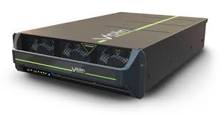

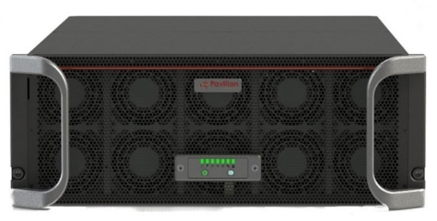

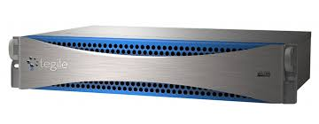
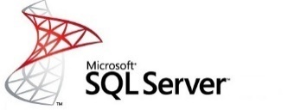

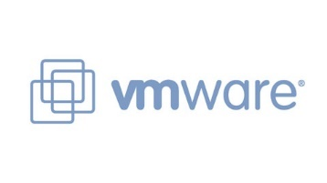



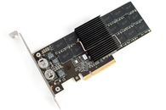


The next step in Performance Storage (R)Evolution…
All Flash Arrays
Pavilion Memory Array
Capacity & Manageability
DAS
Performance (Low Latency and Bandwidth/IOPS)
Notes:
100s of TB per rack-unit, all thin-provisioned
Latency of DAS SSDs
10s of millions of IOPS and over 100 GB/s Bandwidth
10+ 40 GBe ports per rack-unit
Pay as you grow scalability
Standard Ethernet Support
No custom client hardware required
Standards-based protocols
Cost of typical All-Flash-Array

Slide 4






Target Applications for Shared, Low Latency Block Storage
Scale-Out Databases for Analytics/OLTP
Analytics & ETL Applications
Reduce per-rack costs up to 72%
Improve Storage Utilization 2X+
Management Flexibility
Reduce Infrastructure
Shorten Decision Times
Transition to Real-Time Analytics
Increase Accuracy
Driving Continuous ETL

Slide 5
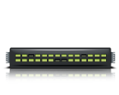
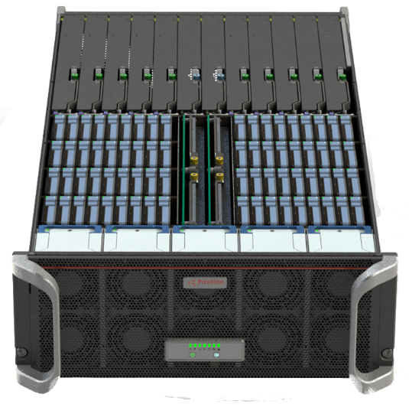
NVMe Over Fabrics-based Enterprise Block Storage Array
Uses Ethernet
NVMe Block Storage Devices Presented to Hosts using community/standard NVMeOF driver – no custom host software required
10s of µs Latency - like DAS SSDs
Full HA capability and hot-pluggable components
Enterprise Data Management (snapshots/clones, thin provisioning, erasure coding)
Thin-Provisioned, virtual NVMe LUNs presented on host tier

Slide 6
Pavilion Product Family
RF-140
Ports (40 Gbe) | 40
Capacity (TB) | 115 / 230 / 460 / 920
Read BW | 120 GB/s
4K Read IOPS | 20 Million
RF-116
Ports (40 Gbe) | 16
Capacity (TB) | 28 / 57 / 115
Read Bandwidth | 48 GB/s
4K Read IOPS | 8 Million
RF-108
Ports (40 Gbe) | 8
Capacity (TB) | 14 / 28 / 57
Read Bandwidth | 24 GB/s
4K Read IOPS | 4 Million
Expansion Options for any model
IO Line Card (4 x 40 Gbe Ports, 2 Storage Controllers)
Capacity Expansion Packs - 7, 14, 28, or 57 TB
*Bandwidth measured using block sizes >= 32K

Slide 7
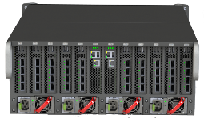

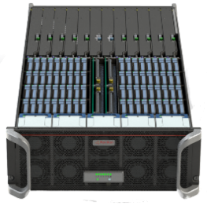
Key Features
Up To 120 GB/S
Bandwidth
Half PB
Capacity (4U)
*1 PB in mid-2017
Thin
Provisioning
RAID-6
Zero
Host
Footprint
Up To 20 Million
4K IOPS
Symmetric
Active-Active
Controllers
Full HA Support
Up To 40 x
40 Gb/S
Ethernet Ports
Pay-As-You
Grow Scalability
in 4U Chassis
High Speed
Data Copies/
Clones

Slide 8
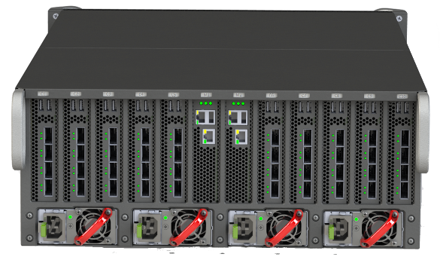
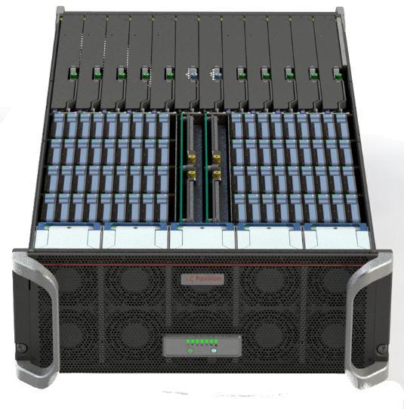
System Overview
Pavilion Memory Array ( Patented 8,966,172 B2)
Management Controller(2)
NVMe
Drive
Array
40 x
40 Gbe
Ports
10 Line Cards
4 ports each
20 I/O Controllers
Internal, Multi-Terabit, Redundant PCIe Fabric

Slide 9
Pay-as-You-Grow Linear Scalability
10 IO Line Cards
5 IO Line Cards
3 IO Line Cards

Slide 10
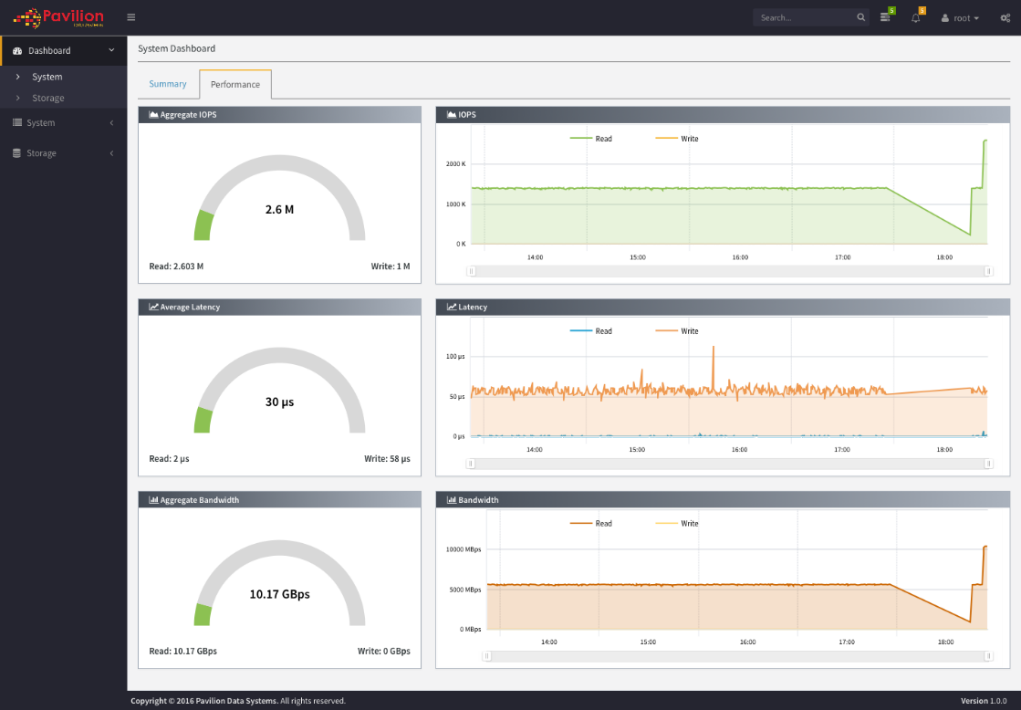
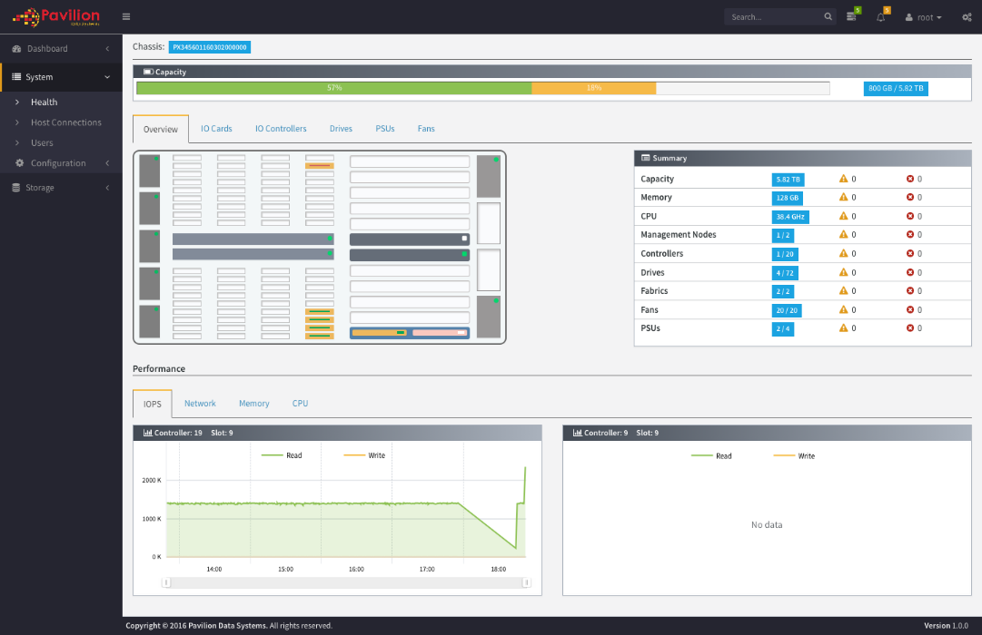
Enterprise Management
Web-Based UI
REST API
SNMP

Slide 11
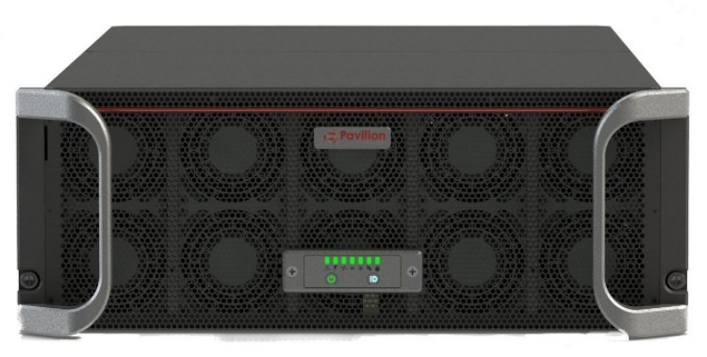
Pavilion: Next-Generation Storage
Game-Changing Class of Storage
  20x the performance, 10x better latency, and 4x the density of a traditional All Flash Array.
Record-breaking Scalability
  Up to 40 x 40 Gbe ports in a 4U appliance, all delivering full bandwidth storage performance.
Reliability
  No Single Point of Failure. Erasure Coding. 6 x 9s Availability.
Scale in Multiple Dimensions
  Performance, Capacity (up to 460 TB in 4U), or both
Ease of Deployment
  Standard Ethernet Connectivity. No custom, host-side hardware required. Leverages standards-based NVMe-over-fabrics protocol. Thin-Provisioned NVMe Volumes presented on each host. QOS/SLA policies per-volume.
Pavilion Data Systems™ Confidential
Page 11

Slide 13
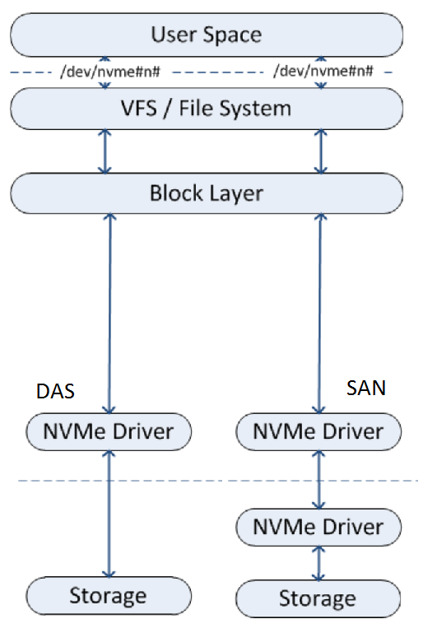
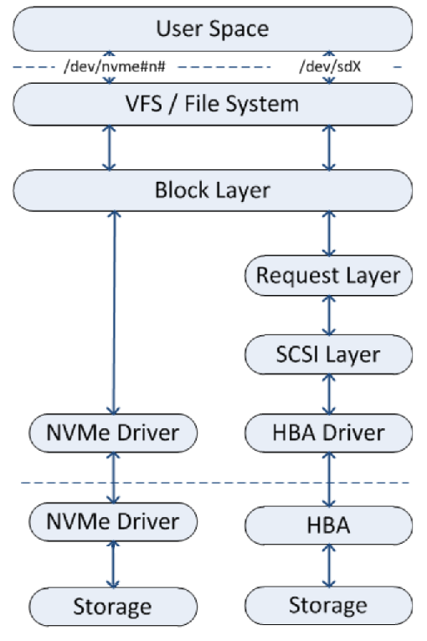
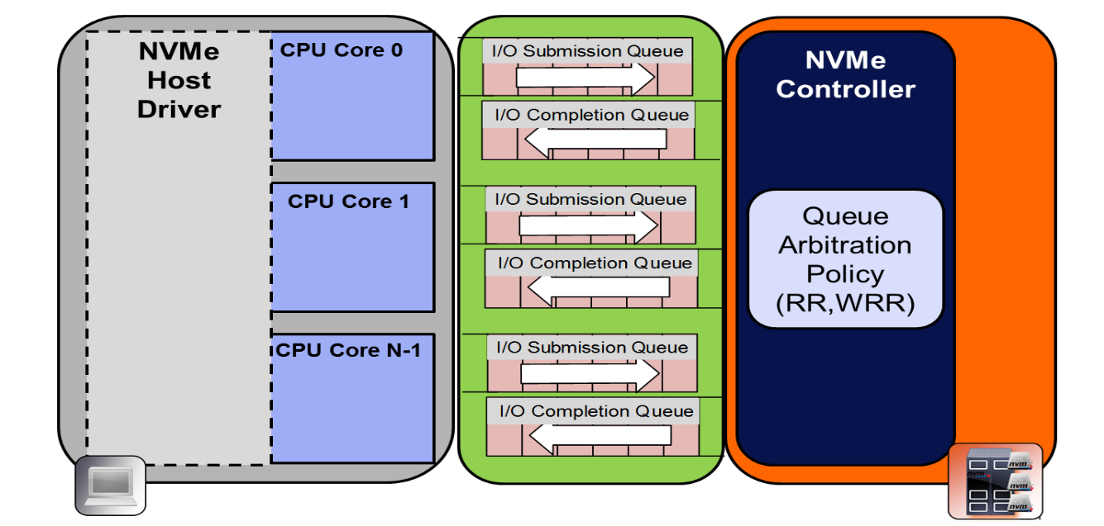
NVMe Basics
All other transports use interrupts and the SCSI stack
  Slows down all CPUs and bottlenecks on a single I/O queue: serial execution
Non Volatile Memory express uses Remote Direct Memory Access (RDMA) with no interrupts and huge per-CPU I/O queues
Doesn’t use the ancient SCSI stack
  Scales linearly with CPU count
  Avoids many data copies for each I/O
  Reduces latency to sub micro-second
  Uses same I/O stack for DAS and SAN
On average, latency
and CPU utilization
are reduced by 50+%
by using NVMe vs
using SCSI
Notes:
(Only use this slide if the audience is not familiar with NVMe. But since that will describe >90% of the audiences for the next year or so… :^))
The I/O stack for all operating systems and SAN transports has a long and distinguished career. Whether FibreChannel or iSCSI for SAN, or NFS, SMB or CIFS for NAS, and especially for SCSI for DAS, the technology is well understood and available from everyone. But because it was designed in the days of 5 ¼” floppies (SCSI stands for Small Computer Systems Interconnect, and was introduced in 1981!), it simply can’t handle the incredible performance of today’s Flash products, whether inside or outside the server’s skin. Because all of the SAN and NAS protocols drop down to SCSI over PCI inside the server, they are all based around processor interrupts and a single I/O queue, forcing all I/O to be done as described by SAS: Serial Attached SCSI. In effect, the I/O from all of your expensive Flash arrays are being squeezed down into a single serial port designed for a 5400 RPM hard drive.
<CLICK> The industry finally got around to recognizing the problem, and proposed a solution to the problem. This is called Non Volatile Memory express, or NVMe. First, NVMe is a transport protocol, which replaces existing protocols like SCSI, SAS and SATA inside the server over PCIe. But it gets rid of a lot of the problems of those protocols:
NVMe bypasses kernel mode for I/O, and uses your user memory for Direct Memory Access inside the server, and Remote Direct Access Memory for SAN and NAS solutions. Effectively, you treat all devices, either local or remote, as if they were local and you have direct memory access to the device for both reads and writes.
NVMe simply doesn’t use interrupts (which are terribly slow for modern devices) but uses RDMA semaphores to let you know when a read or write is finished.
NVMe gets rid of the single I/O queue per system and implements queues of 64K *PER CORE*, and the architecture allows up to 64K queues per device, so you can have a lot of I/O going on at the same time. And finally,
<CLICK> NVMe doesn’t use the SCSI stack. SCSI is simply too slow, with too much overhead, and too much code that was designed for floppy diskettes that is kept around for compatibility reasons, to have any place in ultra-high-speed Flash devices. Multiple groups have measured it, and the results are consistent: moving from SCSI to NVMe will reduce the CPU overhead and I/O latency by more than half, removing a bottleneck which is slowing down existing devices.
The advantages of this are many:
<CLICK> It scales linearly with the number of CPUs. Each core has its own I/O queue with a potential I/O queue depth of 64 thousand entries, and does its own I/O with local user mode memory, with no interrupts, just memory accesses.
<CLICK> The data is transferred to and from user mode memory, directly to and from the target storage device. In the other transports, a write involves copying the data from user mode memory to kernel mode memory, possibly then copying it again to the PCIe card’s memory, and then placed on the transport line. For reads, the data is often take from the transport line into the PCIe card’s memory, copied to kernel mode memory, and then copied again to user mode memory. Each copy is done at memory speeds, but they still take time. NVMe eliminates all of those copies.
<CLICK> The net effect of eliminating interrupts, eliminating huge chunks of the I/O stack and eliminating the data copies, while allowing all of the processors to work in parallel, is to reduce the latency of the I/O to sub micro-second.
<CLICK> NVMe and NVMe over Fabric use exactly the same I/O stack, because they both use RDMA. So the protocol you use to talk to local SSDs and the protocol you use to talk to a SAN based SSD, are identical. NVMe SSDs inside the server are common today, and are demonstrating dramatic performance gains over SAS and SATA SSDs. Because local NVMe and NVMe over Fabric uses the same I/O stack, this same kind of reduction in overhead and increase in performance is available today in the SAN as well.
And what is most interesting, is that you have been thinking about how all of these points apply to the host server, and you are right to think that: high CPU counts, no data copies, and reducing latency are important for the host server to be able to drive the massive number of IOPS that are needed for today’s requirements.
But these points apply equally to the storage array as well. Being able to scale IOPS simply by having more processors, avoiding data copies, reducing latency, and equally importantly, not having the speed of the actual storage SSDs throttled by the SCSI stack but instead using NVMe as a transport for both the SAN and the internal communication, means that we can create a truly high speed, highly scalable, extremely low latency storage array, that delivers on the promise of SSDs and NVMe.

Slide 14


Frictionless Deployment
Host-Side Implementations (JBOFs)
Pavilion = Zero Host Footprint
Applications
Applications
Data Services
Host
NVMeOF, Direct PCIe, or Proprietary Protocol
Network
NVMe Over Fabrics
Data Services
NVMe Drive Pool

Slide 15


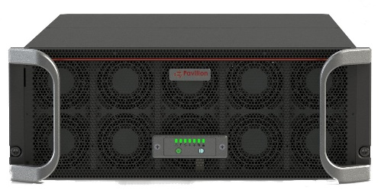
High Speed Data Copies Increase Productivity
Production
Development
QA
Decision
Support
Reporting
Training
Demo
Instant, Space-Efficient, Logical Copies
Full Performance Copies
Reduce Overhead on Servers
Eliminate Backup Windows

Slide 16
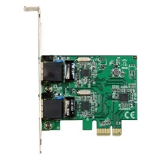
Only NVMe Array with Symmetric Active-Active Controllers
Network Path A
C1
V1
Pavilion NVMe Host Volume V1
C2
V1
IO Line Card 1
C3
Network Path B
C4
Shared NVMe Media Group
V1
IO Line Card 2
Simultaneous, Concurrent Read/Write Access to any volume through multiple Pavilion array controllers
Provides load balancing across multiple network paths and target controllers for improved performance
Delivers failover capability across up to 5 controllers for a given volume

Slide 17
Only NVMe Array with Symmetric Active-Active Controllers
Network Path A
C1
V1
Pavilion NVMe Host Volume V1
C2
V1
IO Line Card 1
C3
Network Path B
C4
Shared NVMe Media Group
V1
IO Line Card 2
Simultaneous, Concurrent Read/Write Access to any volume through multiple Pavilion array controllers
Provides load balancing across multiple network paths and target controllers for improved performance
Delivers failover capability across up to 5 controllers for a given volume

Slide 18
Hardware Overview
Rear View
Top View
Commodity NVMe SSDs (72)
PCIe Fabric Modules (2)
40 GbE Ports
Supervisor/Management Modules (2)
Power Supplies (4)
IO Line Cards (10)
Fans (8)

Slide 19



Pavilion Benefits for Applications
High Performance & Density
Reduce Costs
10X+ improvement in performance and latency vs. All-Flash Array
10x+ more users for the same amount of
infrastructure
Better Decisions from a larger data set
Increase utilization
Reduce Physical Data Copies
Reduce Software Licensing Costs
Faster ROI
Reduced Administrative Costs
High Availability
Control Data Sprawl
Avoid Information Downtime
No Single Point of Failure
Hot-Swappable components
6x9s
Leverage High-Speed Logical Copies
Concurrent Use of Data for Many Purposes
Derive More Value from Data

Slide 20
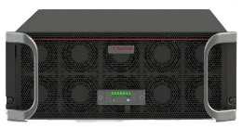
Replace DAS in Scale Out Database Deployments
Reduce per-rack costs up to 72%
Improve Storage Utilization 2X+
  Free up stranded capacity residing on DAS
Management Flexibility
  Less raw storage deployed lowers IT Admin Costs
  Move data sets from one server to another without copying
Reduce Infrastructure
  Less Servers required, or consolidate more DB instances per server
  Eliminate DAS SSDs
  Leverage Full-Performance, Space-Efficient Copies

Slide 21


Accelerate Splunk with Pavilion
Use a single Pavilion Memory Array for all Splunk Indexer Data
Accelerate Search Times up to 100x
Reduce infrastructure footprint up to 4X, along with associated power and cooling costs
Support several hundred indexers from a single shared appliance
Move analysis and decision making from batch to real time
Common standard Ethernet network for servers and storage
Indexer 1
Indexer 2
Indexer 3
Indexer N

Slide 22
Pavilion Delivers A New Class of Storage
 | Traditional All Flash Array (Violin, NetApp EF, Pure, EMC XtremIO, etc) | Pavilion Advantage
External Connectivity Bandwidth | 4-8 GB/s | 20X
Internal System Fabric Bandwidth | < 512 Gb/s | 15X
IOPS and latency | < 1000K IOPs (4K Block) Latency: 1 ms | 25X IOPs 10X Latency
Performance/Server (assume 50 servers/rack) | ~ 1K IOPs (32K Block) ~ 0.08 GB/s Bandwidth | 25X
Performance-Sensitive Workloads will migrate to this new category of storage
Pavilion Data Systems™ Confidential
Page 22

Slide 23

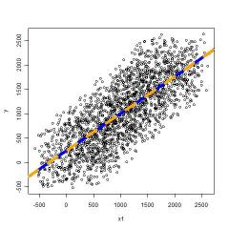



SIEM Requires Fast + Big Data
Shorten Decision Times
  Low Latency/High Capacity platform delivers processing at the speed of business
  Handle Millions of Events per Second and analyze in real time
  Simultaneous analysis using high-speed space-efficient copies
Increase Accuracy
  Stream & Batch Data: Add more data to increase accuracy, rather than optimizing algorithms
  Over 100 TB per Rack-Unit

Slide 24
Pavilion Lowers HyperScale DB CAPEX + OPEX by 72%
$1,328,6400
72% Savings Total Year-1 Costs
38% Savings Infrastructure Costs
$370,1620

Slide 25
Pavilion Lowers Delivery Cost of Traditional Databases
$13,952,500
Pavilion delivers 30% Savings on Delivery Cost vs Traditional AFA
$9,131,000
$6,350,500
Low Latency Drives Savings in multiple areas

