Slide 1
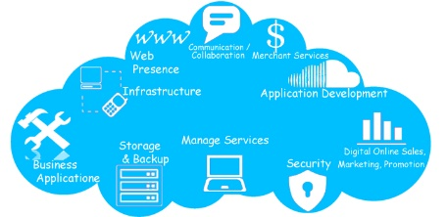




Pavilion’s Target Verticals
Vertical | Feature | Application Category | Requirement
SAAS | Scalability | Analytics, OLTP | Latency
Finance | HFT, Compliance | ETL, Analytics | Bandwidth
Retail | Pricing, Logistics | Analytics | Latency
Media/Entertainment | Video Creation/Edit | Rendering | Bandwidth
eCommerce/B2B2C | Scalability | Analytics, OLTP | Latency

Slide 2
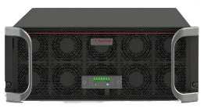






SAAS: Lower Cost and Increase Scale
Reduce per-rack costs up to 72%
Improve Storage Utilization 2X+
  Free up stranded capacity residing on DAS
Management Flexibility
  Less raw storage deployed lowers IT Admin Costs
  Move data sets from one server to another without copying
Reduce Infrastructure
  Less Servers required, or consolidate more DB instances per server
  Use smaller “disk-less” 1U servers
  Eliminate DAS SSDs
  Leverage Full-Performance, Space-Efficient Copies

Slide 3


Financial Institutions Reduce ETL Window up to 5X
Reduce ETL Window 5X
More Simultaneous Usage
Rapid Analysis
Predict Instead of React
Business
Intelligence
Pavilion
Data Warehouse

Slide 4


Global Retailer Increases Revenue & Profits
1700 Stores + E-Commerce
Nightly Pricing Adjustment Process
Before
  Analyze 20% of SKUs nightly from 1000 Stores
After
  Analyze 100% of SKUs nightly from 100% of stores AND E-Commerce

Slide 5



High Performance for Media and Entertainment
Performance to support ingest and editing
Rendering for High-Res 3D
Concurrent work on the same data
without storage degradation
Composing 2D images from multiple layers
Up to 120 GB/s bandwidth from 4U Appliance

Slide 6



B2B2C Global Travel Partner: Maximizing Transactions
Raising the Business Value of Each Customer
Web Services
Customer Centric price recommendations
Just in Time Auctions, Airline bidding
Customer Centric product recommendation
Real-time Airport Shop behavior
Instantaneous Vacation Planning

Slide 8

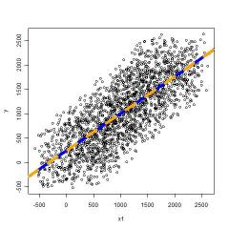



Tackle Bigger Analytics Problems
Shorten Decision Times
  Low Latency/High Capacity platform delivers processing at the speed of business
  Handle Millions of Events per Second and analyze in real time
  Simultaneous analysis using high-speed space-efficient copies
Increase Accuracy
  Stream & Batch Data: Add more data to increase accuracy, rather than optimizing algorithms
  Over 100 TB per Rack-Unit

